Slide 1
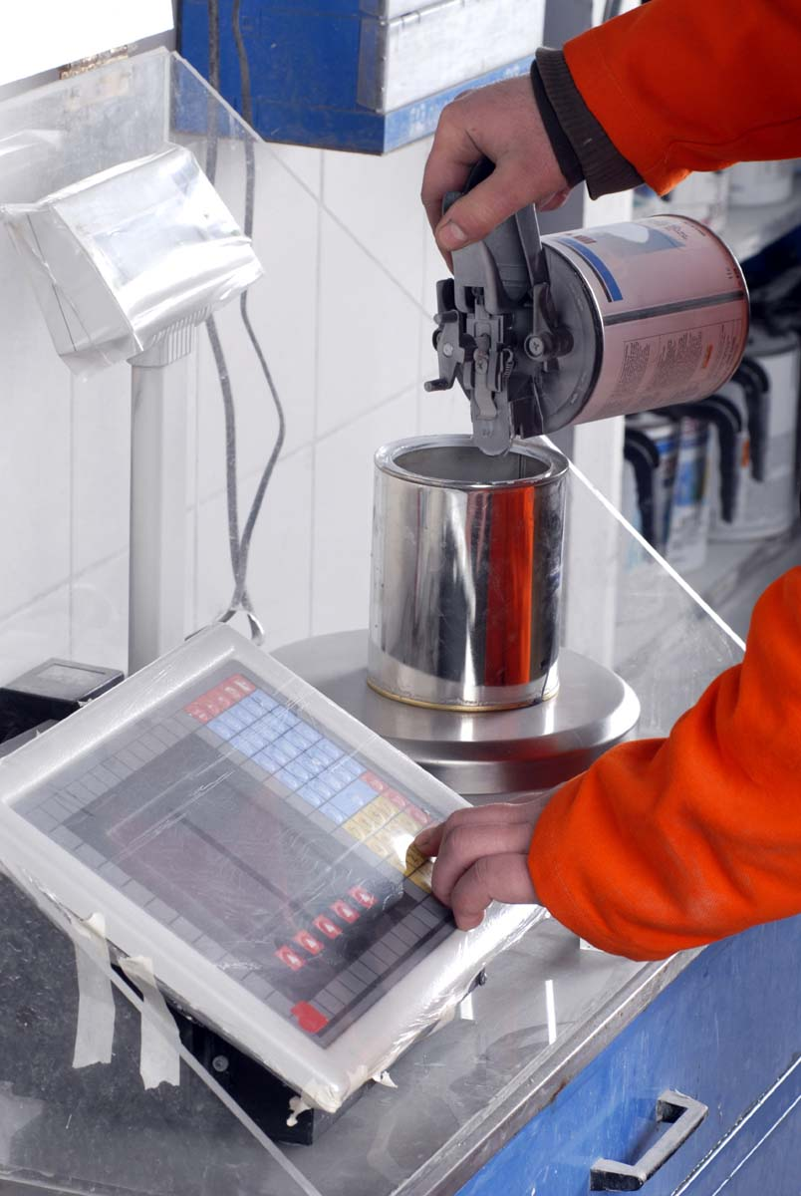
REACH and CLP
What formulators need to know

Slide 2
Purpose of this presentation
This presentation, with notes, was prepared by ECHA, the European Chemicals Agency, to assist you in preparing a presentation about REACH and CLP relating to downstream users. The intention is that you can select relevant slides and modify them as necessary to suit your audience, whether it is management, workers, environmental health and safety professionals, authorities etc. You may use it without additional permission.
This presentation aims to provide relevant and useful information to help formulators to fulfil their obligations under REACH and CLP. It forms part of a series of presentations relating to downstream users and REACH/CLP, which are on the ECHA website. We welcome your comments and suggestions at downstream_users@echa.europa.eu.
Legal notice: The information contained in this presentation does not constitute legal advice and does not necessarily represent in legal terms the official position of the European Chemicals Agency. The European Chemicals Agency does not accept any liability with regard to the contents of this document.
Release: September 2015 Last update: July 2019

Slide 3
Contents
Formulators and their role in REACH and CLP
Communicating information upstream
Communicating information downstream
Classification of mixtures
Managing chemicals of concern in your mixtures
Notes:
This presentation, which forms part of a series, gives a general overview and introduction to key elements related to downstream users and is aimed at a wide range of audiences, including management, workers, environmental health and safety professionals, industry groups, national and local authorities etc.

Slide 4

Formulators and their role in REACH and CLP
Notes:
For more information for formulators, see http://echa.europa.eu/regulations/reach/downstream-users/who-is-a-downstream-user/formulators

Slide 5



Formulators
Formulators produce mixtures, which are usually supplied further downstream
Examples of mixtures: paints,
lubricants, cleaning products and adhesives
…are downstream users under REACH and CLP

Slide 6
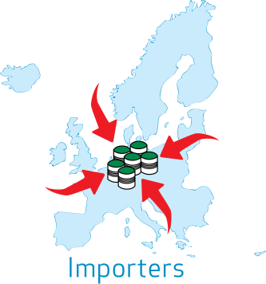


Other suppliers of mixtures
Importer any natural or legal person established within the Community who is responsible for import into the EEA.
Re-filler transfer substances or mixtures from one container to another, generally in the course of repackaging or rebranding.
Distributor any natural or legal person established within the Community, including a retailer, who only stores and places on the market a substance, on its own or in a mixture, for third parties.
Notes:
This presentation is intended for suppliers of mixtures, as they have a key role to play in enhancing the safe use of hazardous mixtures. Formulators are the main suppliers of mixtures but importers, refillers and distributors also supply mixtures. The legal obligations differ somewhat, depending mainly on whether the actor handles the open chemical. The REACH/CLP term “downstream user” is applied to these users of chemicals.

Slide 7


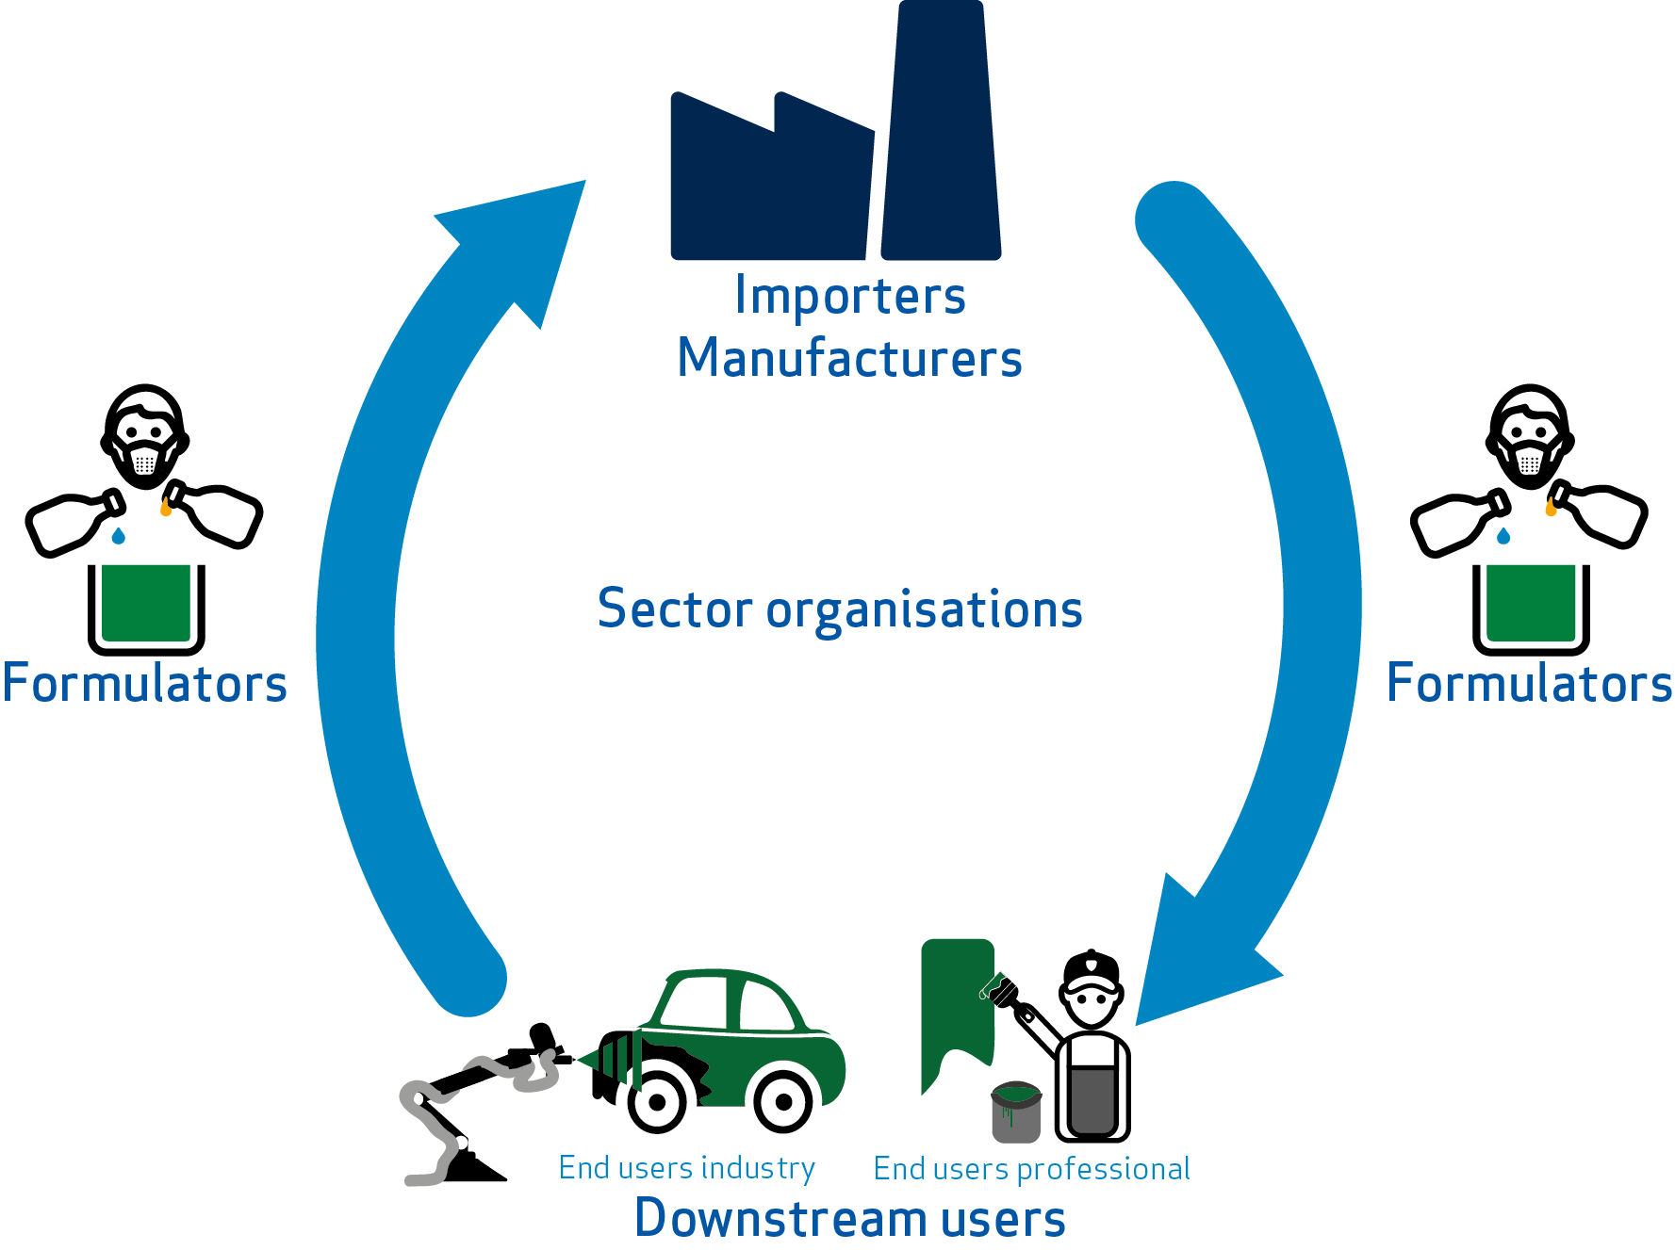

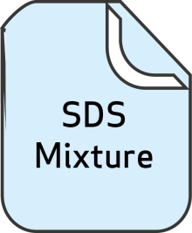

The supply chain
INFORMATION
FOR
REGISTRANTS
SDS: Safety Data Sheet ES: Exposure Scenario
Notes:
This slide illustrates the environment where formulators often act, and the fact that the formulators have a key role to play in the communication both up and down the supply chain. The following slides will explain these tasks in more detail.

Slide 8
Formulators have a central role
Communicating information on uses upstream
Classification, labelling and packaging of mixtures
Communicating information on safe use downstream
Managing substances of concern in mixtures
Notes:
This introduces what will follow in the subsequent slides. The formulators have a central role under REACH & CLP in enhancing the safe use of chemicals by communicating safe use information upstream and downstream in the supply chain. As a formulator, you are responsible for the classification, labelling and packaging of the mixture you place on the market. Hazardous substances in your mixtures may be subject to regulatory actions. The information on these regulatory controls is essential to make sure that mixtures you place on the market comply with REACH and CLP.

Slide 9
Formulators role in communicating upstream
Communicating information on uses upstream
Classification, labelling and packaging of mixtures
Communicating information on safe use downstream
Managing substances of concern in mixtures

Slide 10

Communicating information upstream
Formulators know how their products are intended to be used
Formulators, as downstream users, may provide this information to help registrants (Article 37 of REACH)
Sector organisations gather this information in use maps which are available to registrants – this gives a realistic basis for the chemical safety report and saves time for everyone
Formulators receive better information from registrants when their uses have assessed realistically in the registrant chemical safety report
Formulators – a critical link in the supply chain

Slide 11

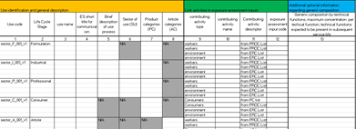

Upstream communication on uses
Downstream industry organisations have developed Sector Use Maps
These describe how chemicals are used in their sector
Registrants can use these when preparing the Chemical Safety Report for registration – next deadline 2018
Check that your sector organisation is active and that your uses are included
Sector Use Maps
INFORMATION
FOR
REGISTRANTS
Notes:
For practical information on how formulators can make their uses known directly to their suppliers or via their sector organisation, see ECHA’s Guidance for downstream users (chapters 3.3 and 3.4). http://echa.europa.eu/documents/10162/13634/du_en.pdf.
Information on use maps is being updated regularly on the ECHA website. https://echa.europa.eu/csr-es-roadmap/use-maps/concept

Slide 12
Formulators role in communicating downstream
Communicating information on uses upstream
Classification, labelling and packaging of mixtures
Communicating information on safe use downstream
Managing substances of concern in mixtures

Slide 13

The safety data sheet (SDS)
SDS are the main communication tool between suppliers and users of substances and mixtures
REACH defines
When an SDS must be provided
What to do when you receive an SDS
What an SDS should contain
What is the format of an SDS
When exposure scenarios should be annexed
Notes:
The communication requirements are defined in Title IV of REACH. The format or content of a safety data sheet is specified in annex II. A user friendly description of safety data sheets, exposure scenarios and what to do when you receive it is provided in http://view.pagetiger.com/ECHAeGuide1-1/Issue1
See also the presentation on “communication in the supply chain” for some additional details

Slide 14


Format and content of the SDS and ES
Main body according to REACH Annex II, including:
  Classification and labelling information
  Registered uses
  Threshold values for exposure (OELV, DNEL, PNEC)
  Physicochemical data
  Toxicological and eco-toxicological data
Exposure scenarios include:
  Use-specific operational conditions
  Use-specific risk management measures
  Exposure estimates
  Additional advice
Notes:
SDS: Prescribed in the legal text - section and subsection headings and contents, covering the properties and hazards, and giving some “recommendations” about the usage, such as first aid and fire fighting measures. The ECHA Interactive guide on safety data sheets and exposure scenarios, available in 23 EU languages, may help the DU to understand what he receives, section by section, and any actions he may need to take: https://echa.europa.eu/safety-data-sheets-and-exposure-scenarios-guide
ES: legally required, but contents not prescribed – except that they must contain information that enables safe use of the substance (i.e. the operational conditions and risk management measures). Work is ongoing with stakeholders to harmonise the ES in terms of format and contents.

Slide 15
When a safety data sheet should be provided
When substance or mixture is hazardous
  Substance or mixture is classified as hazardous
  Substance is PBT/vPvB
  Substance is on the Candidate List
  Non-classified mixture contains certain hazardous substances above specified limits (on request)
It is sold to downstream user(s)
  SDS are not required for the general public but sufficient information for safe use must be provided
  If a substance or mixture is sold to both downstream users and general public, SDS need not be supplied, unless requested by downstream user or distributor
Or an SDS has been requested
Notes:
Candidate List: Substances of concern for human health and/or the environment can be identified and subsequently regulated to make sure that the risks associated with the use of these substances are properly controlled. One regulatory mechanism under REACH is authorisation. A substance identified as a substance of very high concern (SVHC) is placed on the Candidate List, which is the first step in the authorisation procedure. See http://www.echa.europa.eu/candidate-list-table
PBT/vPvP: persistent, bioaccumulative and toxic or very persistent and very bioaccumulative

Slide 16
When exposure scenarios should be provided
When it is a substance
  For mixtures, the supplier may communicate the information from exposure scenarios for ingredient substances in other ways
…and registered > 10 tonnes/year
  A chemical safety assessment is not required for quantities <10 tonnes / year
…and it is hazardous
  Exposure scenarios are generated only for hazardous substances
Notes:
NOTE: A supplier is required to provide relevant ES for a registered, hazardous, substance. For a mixture, the supplier may communicate the information in several ways. He may consolidate the information into (i) an annex of safe use information for the mixture or (ii) the main body of the SDS or (iii) he may provide ES for ingredient substances with a SDS.
A difficulty in knowing when to expect an exposure scenario is that you do not know the quantity manufactured or imported by the registrant.

Slide 17



Formulating mixtures for end users
Supplier 2
Substance A
Supplier 1
Substance A
Supplier 3
Substance B Mixture C
What to communicate and how?
Mixture D (=A+B+C)
Notes:
Getting clear information from suppliers
Different from different suppliers - formats, uses, concentrations, risk management advice etc.
Identifying the information to communicate
The operational conditions (exposure duration, frequency, concentration etc.)
The risk management measures
Establishing ways to communicate the information clearly. Approaches are being developed. https://echa.europa.eu/regulations/reach/downstream-users

Slide 18
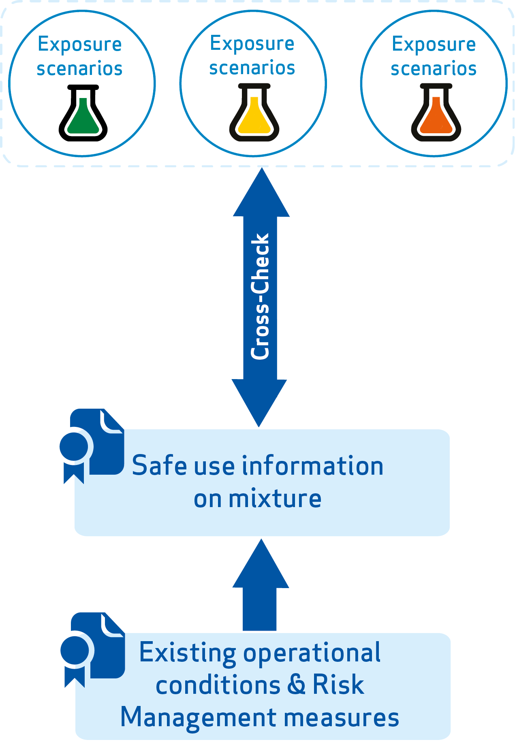
What and how to communicate – the SUMI approach
Existing conditions of safe use are identified within sectors
Provided as Safe Use of Mixtures Information (SUMI)
  Harmonised template
  Uses clear language, pictograms, in sector terminology
Formulator cross checks that use is covered by supplier ES
3
2
1
Notes:
Generally, the “bottom-up” approach and the resultant SUMIs are sector specific, and they aim to provide pragmatic and easily understandable information to end-users. For more information see the related publications in http://www.ducc.eu/Publications.aspx

Slide 19
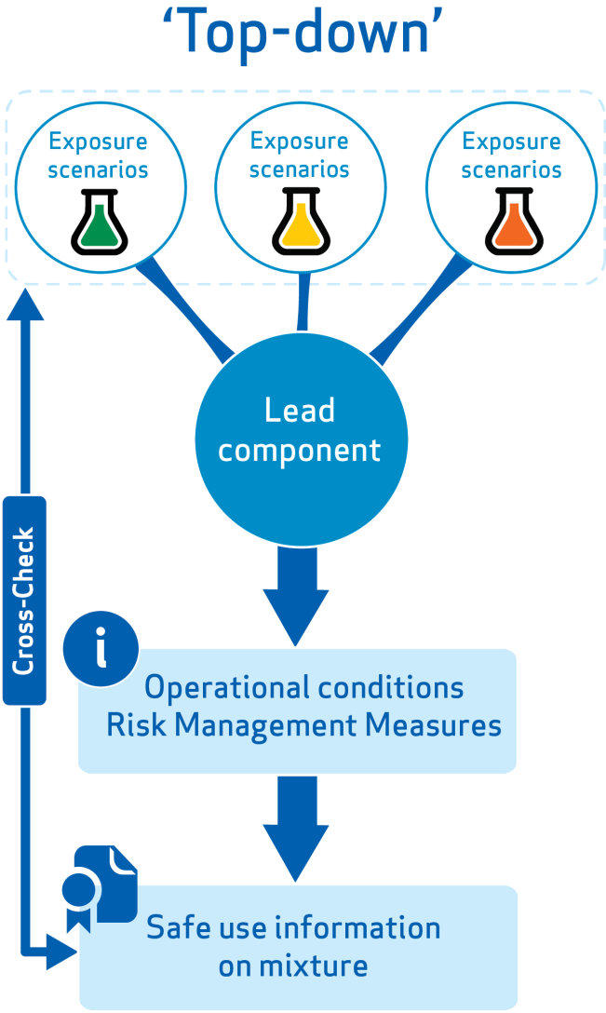
What and how to communicate – the LCID approach
Lead component for various routes of exposure is identified
This gives the OC/RMMs to communicate
This is communicated as safe use information on mixture (possibly using a SUMI-based template)
1
2
3
Notes:
This slide illustrates the main characteristics of the “top-down” method. Here safe use information is derived by consolidating information from ESs of the most hazardous substances, often called the lead components. This information is adjusted taking into account the concentrations of the lead components in the mixture, and also the OCs and RMMs for the mixture use. The outcome, that is the safe use information for the mixture, still needs to be cross-checked against the ESs of the substances. Generally, “top-down” methods are widely applicable regardless of uses and mixture compositions.

Slide 20
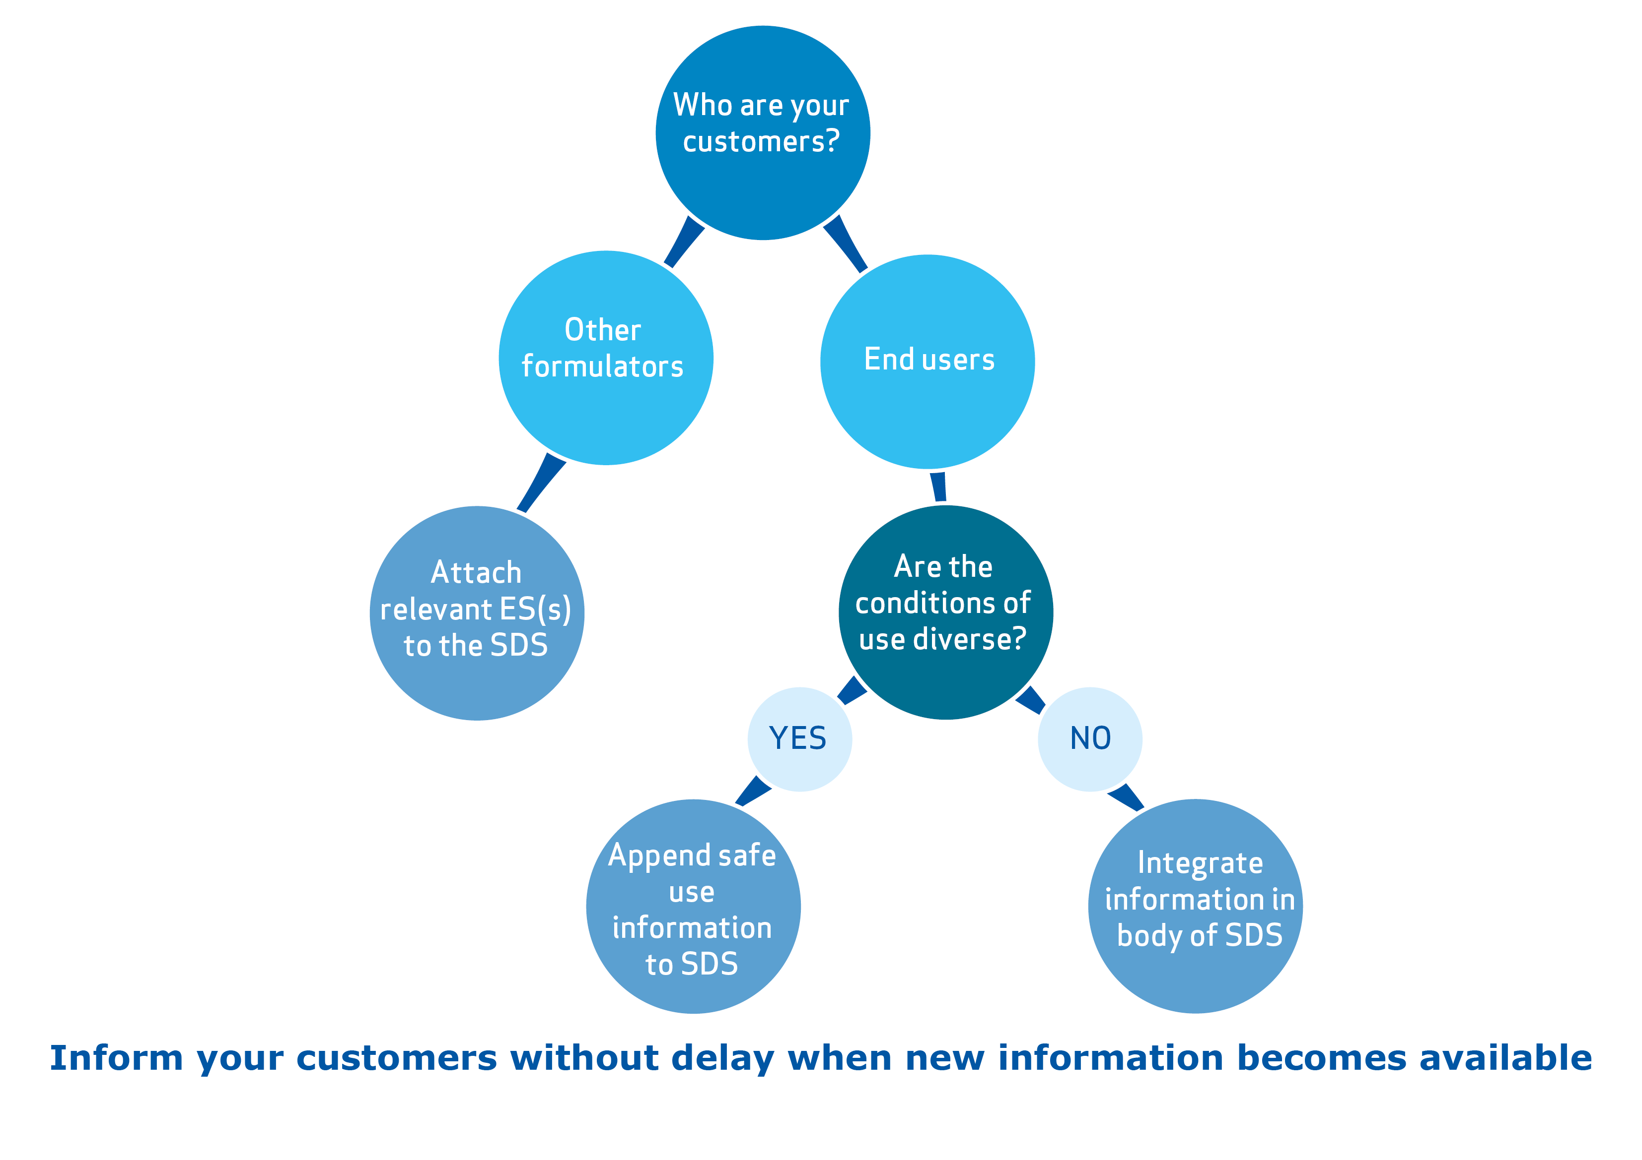
How to communicate the information from the ES
Notes:
This slide illustrates the three ways to communicate the relevant safe use information in the ES of your substances further downstream to the customers receiving the mixtures. If the customers are other formulators, you should attach the relevant ESs to the SDS. This does not necessarily mean all the ESs, but the ones necessary for their safe use. If the customers are end-users of the mixture, the safe use information can either be integrated in body of SDS or appended to the SDS, depending on the diversity of the conditions of use.
See here for legal requirements: http://www.echa.europa.eu/documents/10162/966058/formulator_graph.pdf

Slide 21

Benefits of improved communication in the supply chain
  improved business environment
  improved general confidence in chemical safety and in your products
  improved basis for decision making by regulators
  greater protection for worker safety and health, for consumers and the environment

Slide 22
Classification of mixtures
Communicating information on uses upstream
Classification of mixtures
Communicating information on safe use downstream
Managing substances of concern in mixtures

Slide 23
Key elements of CLP
Classification, Labelling and Packaging Regulation (EC) No 1272/2008
Classify
Manufacturers, importers and downstream users classify substances and mixtures
Label and package
Suppliers label and package them in accordance with CLP
Manufacturers, importers and downstream users notify substance to ECHA’s classification and
labelling inventory
Suppliers communicate information to
Poison Centres
Communicate
CLP implements UN Globally Harmonised System
The classification of certain substances is harmonised
Harmonise
Notes:
Classify : A classification inventory has been built for over 120,000 substances, from over 6 million notifications
Harmonise: Most substances and all mixtures are self classified, but more hazardous substances have agreed, harmonised, classification at EU level

Slide 24
Main formulator obligations under CLP
  You must classify, label and package mixtures in accordance with CLP before placing them on the market
If you are formulating or changing the composition of a mixture, you must derive the classification of the mixture
If you do NOT change the composition of a mixture, you may take over the classification for the mixture already derived by another actor in the supply chain
If you import a hazardous mixture, you must also classify the ingredient substances according to CLP and notify the C&L Inventory (if the substances lead to or contribute to the classification of the mixture).
You must keep up-to-date with new scientific or technical information that may affect the classification of the mixtures you place on the market (Article 15(1) CLP).
Notes:
This presentation deals mainly with classification aspects and CLP obligations with respect to labelling and packaging are not described in detail.

Slide 25
Types of classification
Harmonised
Self-classified
Classification is agreed at EU level
Mandatory, you must use it
May apply only to certain hazard classes*, so don’t forget to take into account the other hazard classes which need to be self-classified.
Applies only to substances
Substances and mixtures are self-classified by manufacturer/importer/downstream user
All mixtures are self-classified
Substances are self-classified as appropriate when classification is not harmonised for the substance or particular hazard
Notes:
See also http://echa.europa.eu/addressing-chemicals-of-concern/harmonised-classification-and-labelling
Questions & answers: http://echa.europa.eu/qa-display/-/qadisplay/5s1R/view/clp/annex+vi+to+clp

Slide 26
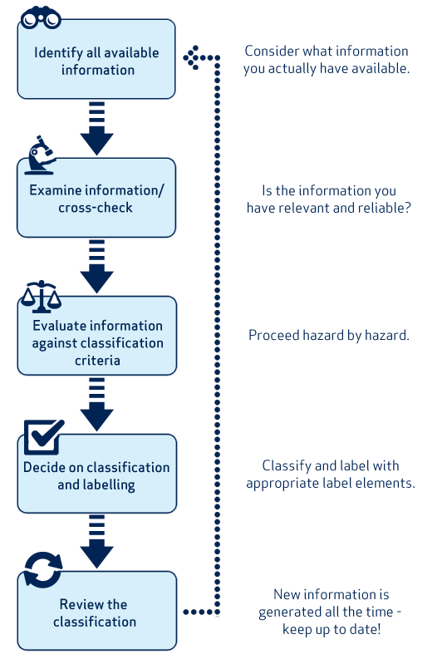
Steps to classify a mixture
echa.europa.eu/support/mixture-classification
Notes:
Each step is described in detail on the ECHA website

Slide 27
Important points when you classify your mixture
If an ingredient substance has a harmonised classification and labelling (Part 3 of Annex VI to CLP), that classification must be taken into account in classifying the mixture.
The supplier is responsible for evaluating all the relevant hazard classes and, where necessary, for adding the self-classification for any additional relevant hazard classes and differentiations not covered by the harmonised classification and labelling.
  Thus, the full classification received from the substance supplier, including both the harmonised classification and the possible self-classification, must be applied when deriving the classification of a mixture.

Slide 28
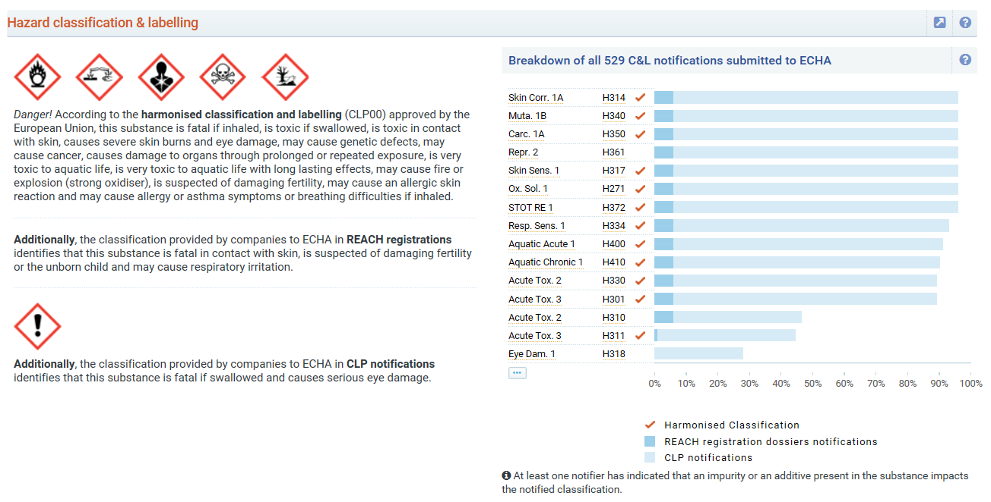
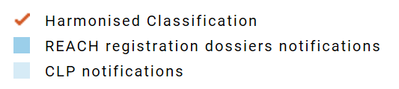
InfoCard/Brief Profile on the ECHA website
InfoCards /Brief Profile on the ECHA website give collated information on substances, including classification and labelling. The submitted data is not verified by ECHA.
C&L segment from a Brief Profile
Notes:
The InfoCard and Brief Profile summarise the non-confidential data on substances as it is held in the databases of the European Chemicals Agency (ECHA). The data is provided by industry and it is not manually verified by ECHA. The quantity and the quality of the information is the responsibility of industry (registrants and notifiers). They are automatically generated; information requirements under different legislative frameworks may therefore not be fully up to date or complete.

Slide 29
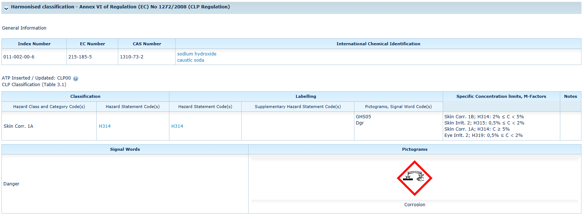
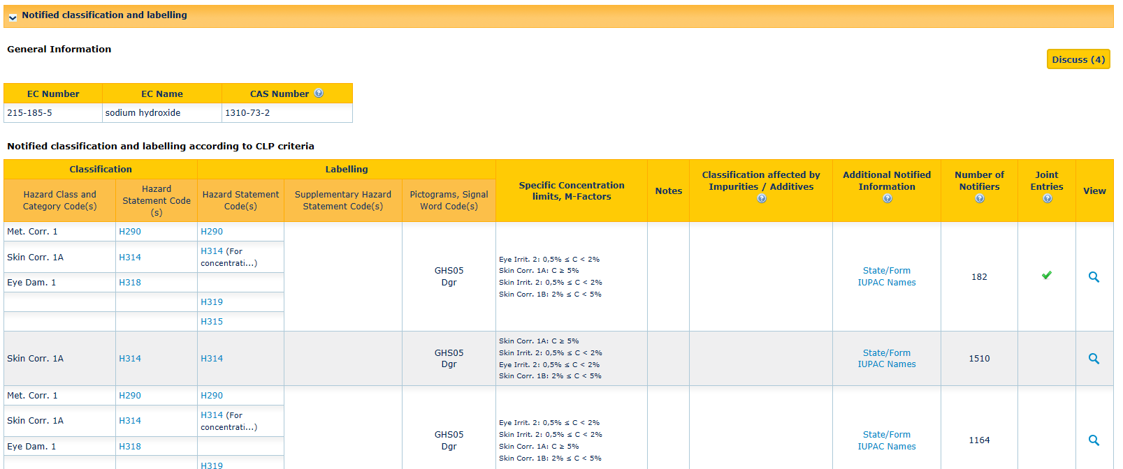
Classification & Labelling Inventory
C&L inventory on ECHA website gives information on notified and registered substances received from manufacturers and importers, plus list of harmonised classifications.
Harmonised classification in the blue fields, notified entries in orange.
https://echa.europa.eu/information-on-chemicals/cl-inventory-database
Notes:
An illustrative example of the C&L inventory. This is a place where you can get information on how others have classified and substance and helps you check if a given classification is plausible. Tips on how to assess the reliability of your supplier’s classification include:
The classification is consistent with the harmonised classification,
The classification is consistent with REACH registration classification. These classifications are likely to be based on more test data than substances that are not registered,
In the C&L Inventory, the classification is marked as a “joint entry”. This means the source is a lead dossier of a REACH registration joint submission. Consequently, the substance classification probably underwent more extensive discussion and review than individual registrations and notifications,
In the “Brief Profile”, the graph distribution shows that a substantial proportion of notifiers assign a given classification (although there is not always safety in numbers).

Slide 30
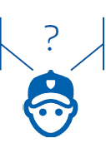
Why does the same chemical sometimes have different classifications?
From supplier A: Corrosive, harmful if swallowed
From supplier B: Irritant, toxic if swallowed
Different hazardous impurities, additives or ingredients
Different properties such as the physical form, the pH, the flash point
Different conclusions from scientific studies
For mixtures, different classification of the ingredient substances used for mixture classification
Contact your suppliers and encourage them to adopt a common classification.

Slide 31


Which classification to use?
If there is a harmonised classification, you must use it. Otherwise you could:
Adopt the most stringent classification – precautionary approach
Adopt the classification you are most confident – justification needed
Classify the chemical yourself – expertise required
Contact your suppliers and encourage them to adopt a common classification.
Notes:
The primary source of information for a downstream user is always their supplier.

Slide 32
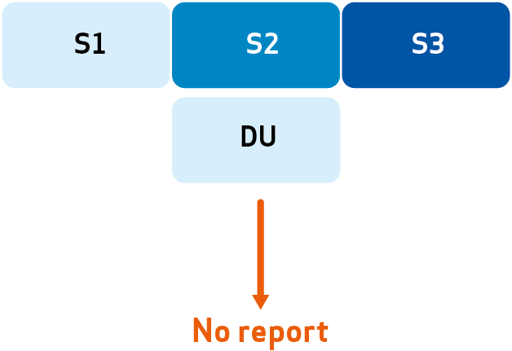
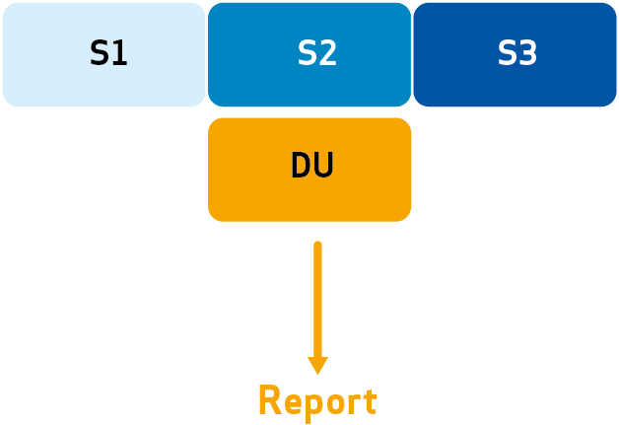
DU report on classification differences
  You may decide to classify an ingredient substance differently to that of all of your suppliers
  If you do that, the REACH Regulation requires you to report this to ECHA
Supplier classification
DU classification
  Note: Reporting classification differences is not required for a substance used in quantities less than 1 tonne per year
  echa.europa.eu/web/guest/support/dossier-submission-tools/reach-it/submitting-a-downstream-user-report-classification-differences
Notes:
As long as your classification is the same as any one of your suppliers, you do not need to report to ECHA.

Slide 33
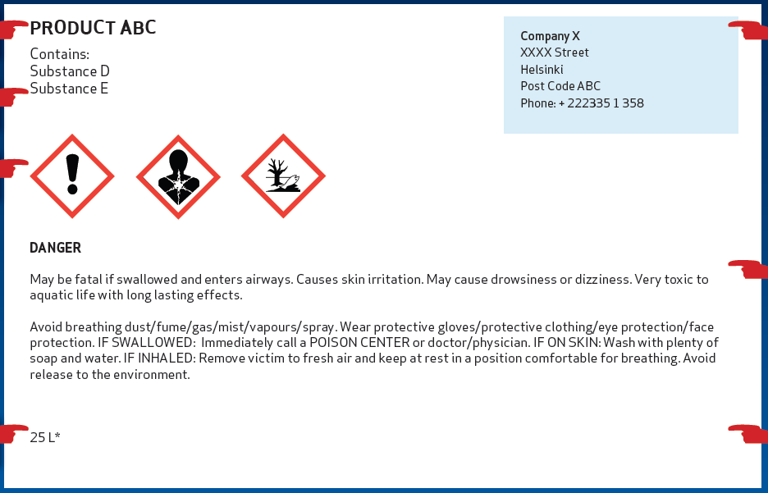
Label and Package your mixture
+
If the mixture is classified as hazardous, you must ensure that it is labelled and packaged in accordance with CLP before placing it on the market.
You, as supplier, are responsible for the information on the label. The information on the label must be consistent with the information on the SDS.
The packaging of hazardous chemicals should keep workers and the environment safe from unintended contact.
Notes:
If the mixture is classified as hazardous, you must ensure that it is labelled and packaged in accordance with Titles III and IV of CLP, before placing it on the market. If the mixture is covered in Part 2 of Annex II to CLP, it may not be placed on the market, unless it is labelled in accordance with Title III of CLP. The chemical label information must be consistent with the information in Section 2.2 of the SDS.
The packaging of hazardous chemicals should keep workers and the environment safe from unintended contact. If you aren’t satisfied with how the chemicals you receive are packaged, contact your supplier.
The packaging requirements for hazardous chemicals are specified in the CLP Regulation and those most relevant for the workplace are:
The packaging should be designed so the hazardous contents cannot escape. Packaging should not be susceptible to being damaged by its contents and should be strong enough to meet the normal stresses and strains of handling.
Packaging with replaceable fastenings should be designed so that they can be repeatedly refastened without the contents escaping.

Slide 34
Managing chemicals of concern
Communicating information on uses upstream
Classification, labelling and packaging of mixtures
Managing chemicals of concern in your mixtures
Communicating information on safe use downstream

Slide 35
Regulatory control of chemicals of concern
Authorities control risks at a regulatory level by identifying and regulating substances of concern under REACH and CLP. The typical approach is:
Identify substance of concern
Analyse the risk management options
No action
Harmonised classification and labelling
Candidate List
Authorisation List
Restriction
Other legislation
Notes:
Substances with certain hazard properties can be of concern for human health and/or the environment. Authorities aim to identify and subsequently regulate such substances to make sure that the risks associated with their use are properly controlled. The regulatory mechanisms under REACH/CLP are authorisation, restriction and harmonised classification and labelling. A substance identified as a substance of very high concern (SVHC) is placed on the Candidate List, which is the first step in the authorisation procedure. See http://www.echa.europa.eu/candidate-list-table. There is an EU-wide commitment to have all relevant currently known substances of very high concern (SVHCs) included in the Candidate List by 2020, as described in the SVHC roadmap http://www.echa.europa.eu/addressing-chemicals-of-concern/substances-of-potential-concern
See also the detailed presentation on identifying and controlling chemicals of concern under REACH and CLP; http://echa.europa.eu/documents/10162/21813558/identify_chemicals_of_concern_en.pptx

Slide 36

Key role of formulators in controlling chemicals of concern
Formulators can:
Look for safer alternatives to substances of concern in their products.
  Harmful substances are eliminated from mixtures supplied downstream
Participate in public consultation and provide realistic information to registrants (usually via sector organisations)
  Regulatory decisions are based on good information
Communicate clearly to customers about hazards, safe use advice and regulatory status
Users of chemicals of concern are well informed
Notes:
Formulators are encouraged to follow this process and to give their contributions during the different consultation phases of the authorisation, restriction and harmonised classification and labelling processes.
A good starting point is the Public Activities Coordination Tool (PACT) . PACT lists the substances for which a Regulatory Management Option Analysis (RMOA) is either under development or has been completed since February 2013. https://echa.europa.eu/pact

Slide 37
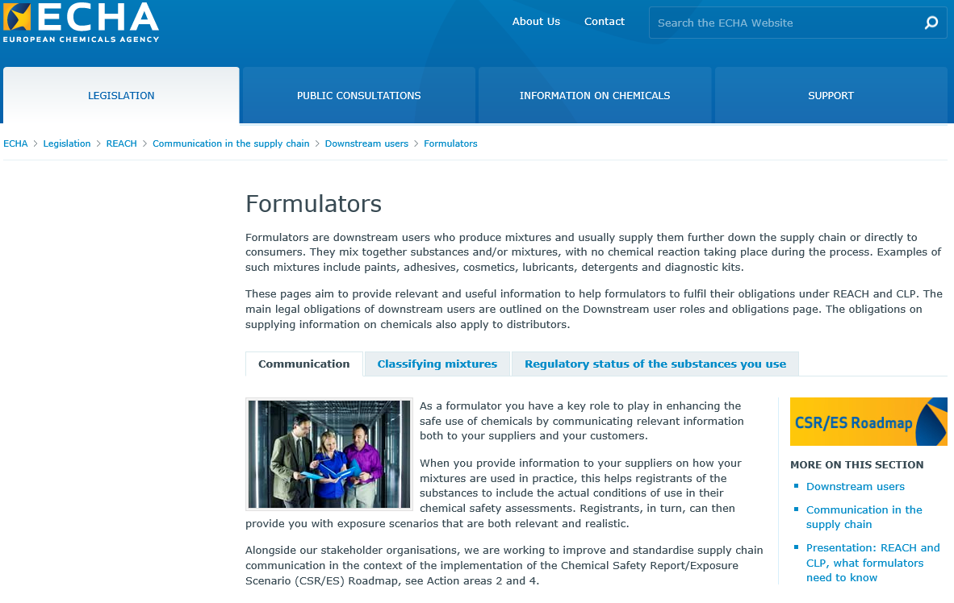
Information for formulators on the ECHA website
echa.europa.eu/regulations/reach/downstream-users/who-is-a-downstream-user/formulators
Notes:
This is a useful starting point for information for formulators on the ECHA website.

Slide 38
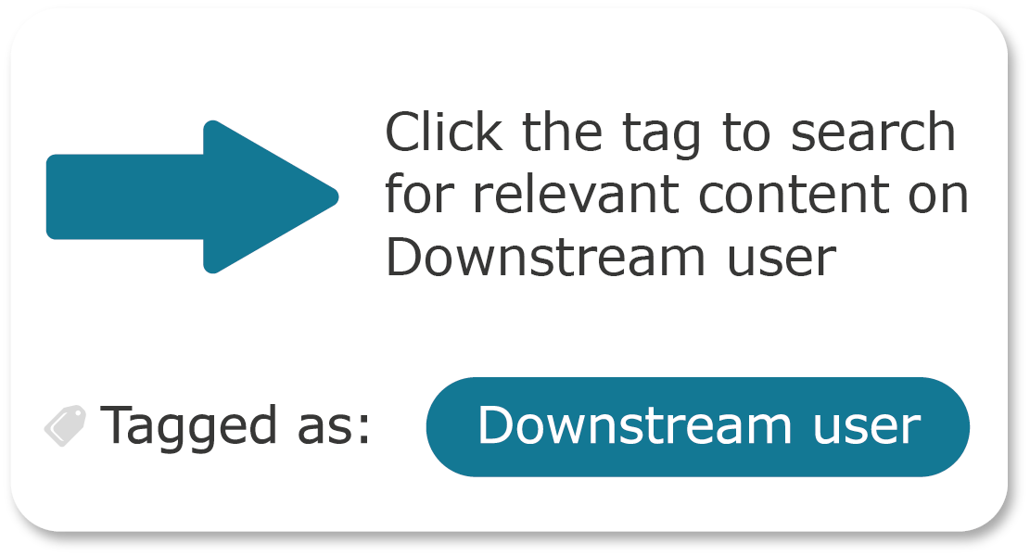
Information for Downstream users on the ECHA website
The technical, scientific and administrative aspects of REACH and CLP are managed by ECHA, the European Chemicals Agency.
Web pages containing information specifically aimed at Downstream users have been tagged “Downstream user”. Click the tag to retrieve the list of relevant content.
echa.europa.eu/regulations/reach/downstream-users
Notes:
For more general information on REACH and CLP, consult the ECHA website at echa.europa.eu

