Slide 1

Communication in the Supply Chain
Manufacturer
Importer
Distributor
Article producer
Formulator
End user
Overview and advice for downstream users

Slide 2
Purpose of this presentation
This presentation, with notes, was prepared by ECHA, the European Chemicals Agency, to assist you in preparing a presentation about REACH and CLP Regulations relating to downstream users. The intention is that you can select relevant slides and modify them as necessary to suit your audience, whether it is management, workers, environmental health and safety professionals, authorities etc. You may use it without additional permission.
This presentation gives a brief overview of how communication in the supply chain can work effectively. A related presentation “how to check the exposure scenario” gives more specific advice related to the actions for downstream users when they receive exposure scenarios. They form part of a series of presentations relating to downstream users and REACH/CLP, which are on the ECHA website. We welcome your comments and suggestions at downstream_users@echa.europa.eu.
Legal notice: The information contained in this presentation does not constitute legal advice and does not necessarily represent in legal terms the official position of the European Chemicals Agency. The European Chemicals Agency does not accept any liability with regard to the contents of this document.
Release: May 2015, Last update: July 2019

Slide 3
Contents
Communication flow in the supply chain
Information in the supply chain
What to do when you receive exposure scenarios
Notes:
This presentation, which forms part of a series, gives a general overview and introduction to key elements related to downstream users and is aimed at a wide range of audiences, including management, workers, environmental health and safety professionals, industry groups, national and local authorities etc.

Slide 4

Communication flow in the supply chain

Slide 5
Communication flow in the supply chain
Upstream
Downstream
Manufacturer Importers
Formulator
Information
on uses
Information
on safe use
Formulator
End user
Users of articles
Notes:
Upstream communication flow (right/obligation): there are a number of options, even more than displayed in the picture, but information about the substance uses needs to flow upstream to the registrant. It can be directly from each actor (end-user, DU, or formulator), or via a sector organisation etc. Depending on the supply chain, information can also flow from a DU to a formulator to a registrant, and may also include distributors.
Downstream communication flow (obligation): information flows downwards to the relevant actor(s), following the substance supply chain. If the substance becomes part of a mixture, then the formulator has to take some action with the substance information he receives to make it applicable for his mixture, before passing it down to his customers. End users integrating substance into articles may have to communicate information to the users of the articles.

Slide 6
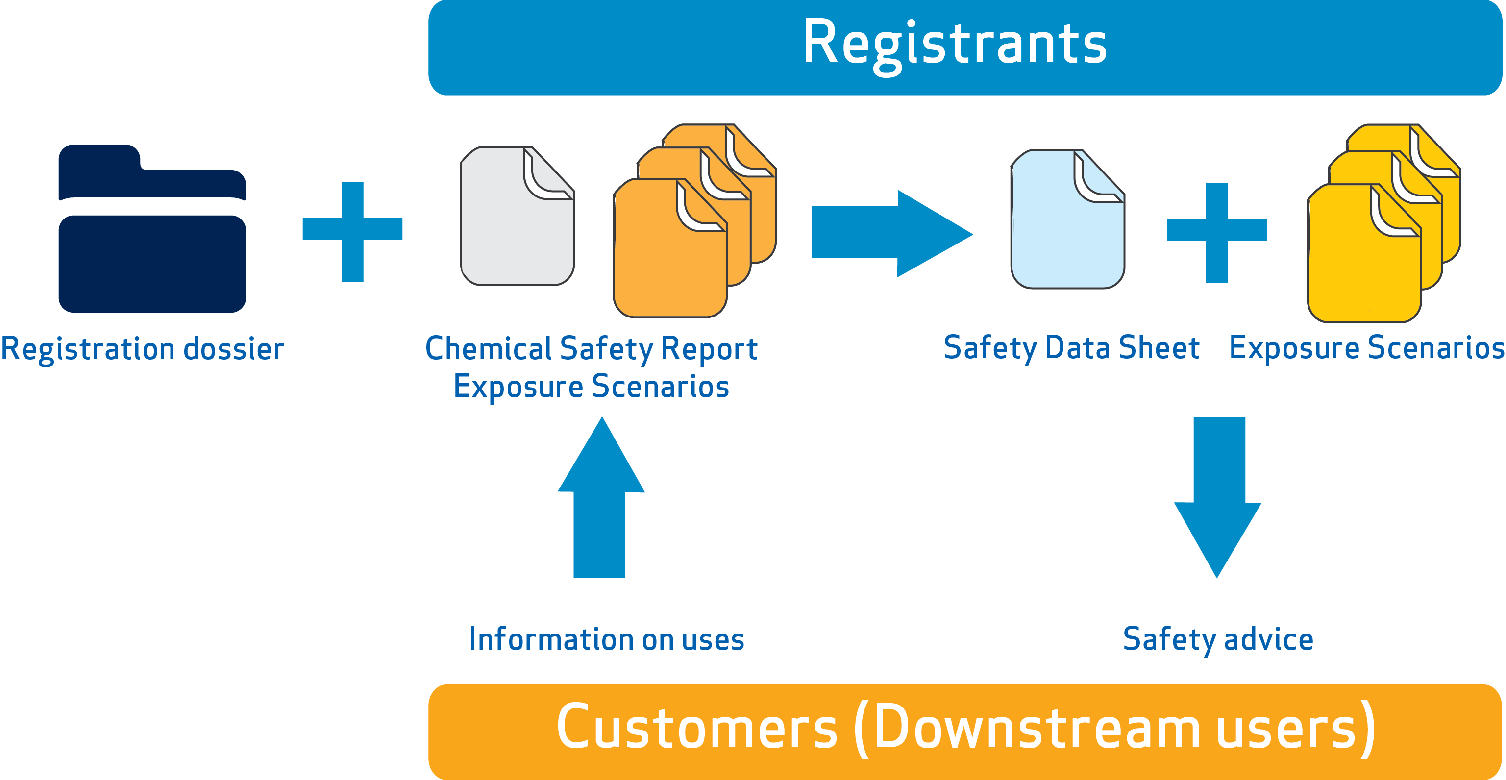
Communication in the supply chain
Notes:
Who is to prepare and provide which information in the supply chain?
The registrant of a substance is obliged to prepare the registration dossier, and for substances that are manufactured or imported more than 10 tonnes per year, this includes also the chemical safety report.
The registrants are required to assess the use of the substance throughout its life cycle. Therefore, as a first step, he needs to gather information on the uses of his substance in the supply chain, for example, from his customers.
Registration dossier and the CSR document the conditions of safe use. Exposure scenarios were introduced with REACH, and they document conditions of safe use for specific uses or groups of uses. Exposure scenarios submitted to ECHA are expected to contain thorough justifications for the information that is included.
CSR remains with ECHA, while the safety data sheet, which should contain information which is consistent with the CSR, is the vehicle to communicate information on safe use to the customers.
Safety data sheets, may include exposure scenarios. Exposure scenarios for communication are expected to be simpler than ES submitted to ECHA, and they should concentrate on outlining in a clear manner the operational conditions and risk management measures which result in safe use of that substance. The use of standard formats and phrases is recommended.
ECHA has published annotated templates and illustrative example on ES for communication (http://echa.europa.eu/support/guidance-on-reach-and-clp-implementation/formats)

Slide 7
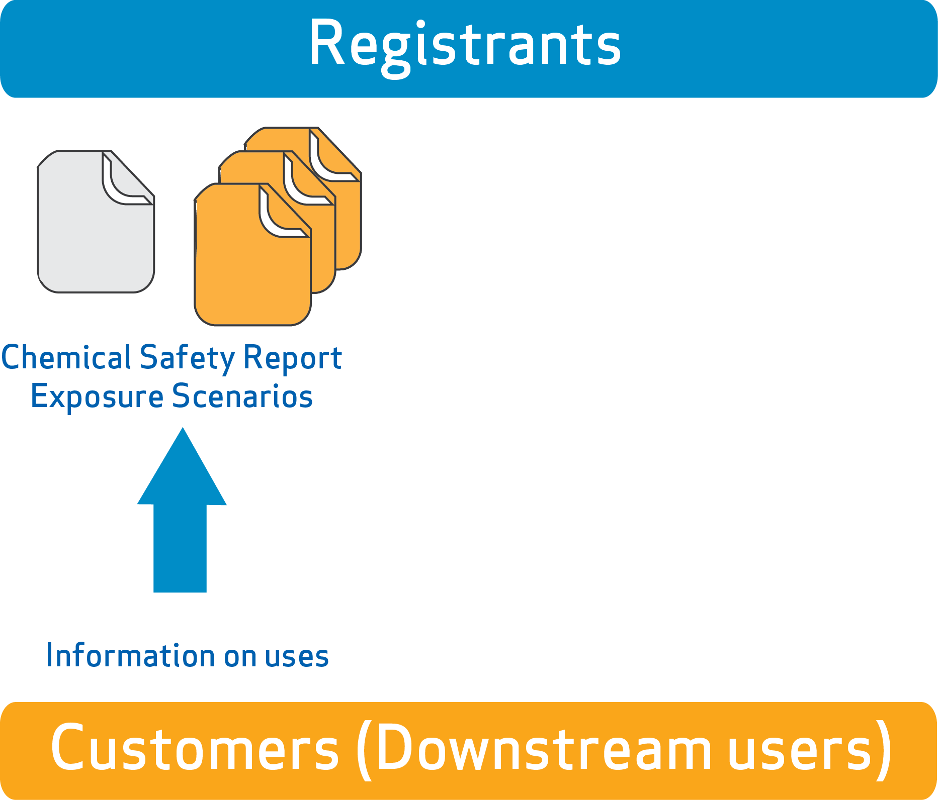

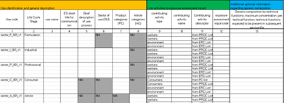
Communication up the supply chain
Better information to suppliers results in better advice on safe use from suppliers
If you have new information on
  hazards or
  inappropriate risk management measures in the safety data sheet
you must communicate it
to your supplier
Sector Use Maps
Notes:
Communicating uses to the registrants
Downstream users have the right to inform their uses to the registrants in order to have them included in the registrant’s CSR. The registrant, however, may decide not to take them on board.
The information flow is most efficiently managed by sector associations, and they have developed use maps to cover typical uses and conditions of use in their sector. Individual companies should contact their sector organisation as a first step.
When there is a need to inform a registrant about your own use directly, harmonised templates should be used in order to standardise the communication flow. The use map template can be useful for this purpose as well.
For more information on use maps, see https://echa.europa.eu/csr-es-roadmap/use-maps/concept

Slide 8

Sector Use Map Package - Background
  Aims and objectives
    To develop a harmonised, effective way for downstream users to inform registrants on how substances are used
    To provide a basis for relevant and realistic assessments
    To promote useful advice on safe use of chemicals
    To provide information that can be readily processed by registrants using IT tools
    To communicate on a sector-wide basis and avoid time-consuming communication with individual downstream users
    To provide DUs with harmonised ES from different registrants based on proposed standard phrases
Status
  Based on Use template by DUCC (2009)
  Templates finalised and published first half of 2016
  By July 2019, 10 industry sectors have published their use map files
Notes:
Sector Use Maps
DUs can to provide information to registrants on uses and use conditions. The Sector Use Maps is one way that can help facilitate this in a format that registrants can understand, with the relevant inputs they require for their assessments.
Background and development under the exchange network on exposure scenarios (ENES). For more information see https://echa.europa.eu/about-us/exchange-network-on-exposure-scenarios.

Slide 9
Sector Use Maps - Format
Provides overview of the common uses in a sector arranged by life cycle stage (manufacture, formulation or re=packing, use at industrial sites etc.)
Each use is described by a use name and some market information
The ES short title for communication is included
The contributing activities for each use are given
The corresponding links to exposure assessment inputs are given. These provide the conditions of use to be used when preparing an exposure assessment for the contributing activity.
Example: Widespread use by professional workers of a cleaning product might include contributing activities for workers of manual spraying and wiping, and for the environment (indoor use)
9
Notes:
Format comprised of 2 essential parts:
Use description part
- Realistic and harmonised description of the major part of the market (good for authorities and for DUs)
- Facilitating the identification of relevant uses by registrant
2. Input to assessment and generation of exposure scenarios for communication
- Realistic conditions of use as input to exposure estimation (SpERCs, SCEDs, SWEDs)
- Include how the communication of the condition of use is expected (relevant standard phrases).
Updated format includes:
- Alignment with other developments e.g.R.12 Guidance and IUCLID
- Integrate references to exposure assessment inputs: SWEDs, SPERCs, SCEDs
- Clarifying points from previous experience and testing

Slide 10
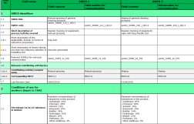

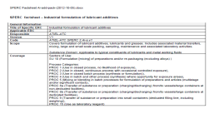
Sector Use Maps - Inputs
For each contributing activity in a Use Map, links are provided to exposure assessment inputs for workers, consumers and the environment
Exposure assessment inputs
Workers
Use map
Workers: Sector-specific Worker Exposure Description (SWED)
Consumers: Specific Consumer Exposure Determinant (SCED)
Environment: Specific Environmental Release Category (SPERC)
SWED
Use description
Consumers
SCED
Environment
SpERC
Notes:
Inputs to the sector use maps for workers, the environment and consumers.

Slide 11
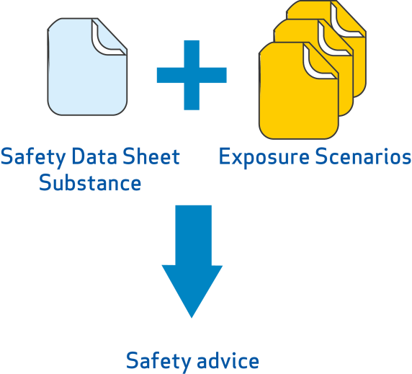





The formulator role –
Communication down the Supply Chain
Formulator receives extended safety data sheets for substances from his suppliers
Identifies and consolidates relevant advice to provide for safe use of the mixture
Provides safety data sheets for hazardous mixtures to downstream users, together with consolidated information on safe use
Customers receive clear, relevant information so they can use the mixtures safely
Notes:
For more information see the presentation REACH and CLP: what formulators need to know at https://echa.europa.eu/regulations/reach/downstream-users/presentations-for-downstream-users.

Slide 12

Information in the supply chain

Slide 13




The safety data sheet (SDS)
REACH defines
When a SDS must be provided
What to do when you receive a SDS
What a SDS should contain
What is the format of a SDS
When exposure scenarios should be annexed
Classification and labelling information must be provided in accordance with the CLP Regulation
Notes:
The communication requirements are defined in Title IV of REACH. The format or content of a safety data sheet is specified in annex II. A use friendly description of safety data sheets, exposure scenarios and what to do when you receive it is provided in this guide https://echa.europa.eu/safety-data-sheets-and-exposure-scenarios-guide.

Slide 14
When a safety data sheet (SDS) should be provided
When substance or mixture is hazardous
  Substance or mixture is classified as hazardous
  Substance is PBT/vPvB
  Substance is on Candidate List
  Non-classified mixture contains certain substances above specified limits (on request)
It is sold to downstream user(s)
  SDS are not required for the general public but sufficient information for safe use must be provided
  If a substance or mixture is sold to both downstream users and general public, SDS need not be supplied, unless requested by downstream user or distributor
Or it has been requested
Notes:
Candidate List: Substances of concern for human health and/or the environment can be identified and subsequently regulated to make sure that the risks associated with the use of these substances are properly controlled. One regulatory mechanism under REACH is authorisation. A substance identified as a substance of very high concern (SVHC) is placed on the Candidate List, which is the first step in the authorisation procedure. See http://www.echa.europa.eu/candidate-list-table
PBT/vPvP: persistent, bioaccumulative and toxic or very persistent and very bioaccumulative

Slide 15
When exposure scenarios should be provided
When it is a substance
  For mixtures, the supplier may communicate the information from exposure scenarios for ingredient substances in other ways
…and registered > 10 tonnes/year
  A chemical safety assessment is not required for quantities <10 tonnes / year
…and it is hazardous
  Exposure scenarios are generated only for hazardous substances
Notes:
NOTE: A supplier is required to provide relevant ES for a registered, hazardous, substance. For a mixture, the supplier may communicate the information in several ways. He may consolidate the information into (i) an annex of safe use information for the mixture or (ii) the main body of the SDS or he may provide ES for ingredient substances with a SDS.
A difficulty in knowing when to expect an exposure scenario is that you do not know the quantity manufactured or imported by the registrant.
PBT/vPvP: persistent, bioaccumulative and toxic or very persistent and very bioaccumulative

Slide 16

Valid reasons for having a SDS
without exposure scenarios annexed
Substance is:
  not hazardous
  exempt from registration
  registered as an intermediate under strictly controlled conditions
  registered below 10 tonnes/year
SDS is:
  provided on a voluntary basis
  for a mixture
Safety Data Sheet
Notes:
A DU may receive an SDS without any ES attached, and there may be valid reasons why this is so.
Basically the ES is one output of the chemical safety report (CSR), which is required for hazardous substances registered in quantities greater than 10 tonnes/year (Articles 14 and 37) . So for the reasons outlined above if no CSR was required there will be no ES.

Slide 17


Format and Content of the SDS
Main body according to REACH Annex II, including:
  Classification and labelling information
  Registered uses
  Threshold values for exposure (OELV, DNEL, PNEC)
  Physicochemical data
  Toxicological and eco-toxicological data
Exposure scenarios include:
  Use-specific operational conditions
  Use-specific risk management measures
  Exposure estimates
  Additional advice
Notes:
SDS: Prescribed in the legal text - section and subsection headings and contents, covering the properties and hazards, and giving some “recommendations” about the usage, such as first aid and fire fighting measures. This guide may help the DU to understand what he receives, section by section, and any actions he may need to take: https://echa.europa.eu/safety-data-sheets-and-exposure-scenarios-guide
ES: legally required, but contents not prescribed – except that they must contain information that enables safe use of the substance (i.e. the operational conditions and risk management measures). The annotated templates shown at the link present the recommended structure based on practical experience and moves toward a harmonised format within the industry, and include examples of the type of information that should be present. Some elements of the template are subject to further development.

Slide 18



  Information in the supply chain
Activities are taking place as part of the ENES programme to improve the information generated and provided
Chemical safety assessment
  Ensuring assessments are accurate, realistic and relevant, and based on sector information on good practices
  Harmonisation of format and content, incl. table of contents
  Development of standard phrases (ESCom Package)
  Annotated templates and examples
  Automated IT communication
  Developing agreed methodologies to identify and communicate safe use information of mixtures
Exposure scenarios
Mixtures
Notes:
As part of ENES, a great deal of work has gone into developing and harmonising the ES format and contents.
Currently there are different formats in use, which can confuse DUs, who may not be able to find relevant ES, distinguish within an ES which is the relevant information, distinguish if two different ES are describing the same use etc. Stakeholders have worked together to develop a table of contents, short titles, harmonisation of formats, phrases etc. to enable greater clarity, understanding, and use of the information.
Proposed annotated templates can be found here: http://echa.europa.eu/support/guidance-on-reach-and-clp-implementation/formats
As the ES comes from the CSA/CSR, stakeholders are also looking at certain aspects of this, that affect the ES.

Slide 19

What to do when you receive exposure scenarios

Slide 20
What to do when you receive ES
Check that your use and customer use is covered
Check that the conditions of use match your actual conditions
Take necessary actions
If you have data indicating that applying Exposure Scenario leads to unsafe use, inform your supplier and take actions to control the risks
20
Notes:
When you receive an ES the first thing to check is if your and your customer’s foreseeable uses and conditions of use are covered. The possible further actions you need to take, depending on the outcome of your check, will be explained in the coming slides. In any case, if you are aware of data indicating that applying the ES leads to unsafe use, you should inform your supplier and implement adequate control of the risk.
For more information check the practical guide “How downstream users can handle exposure scenarios” at https://echa.europa.eu/practical-guides

Slide 21
What to do when you receive ES and you are a formulator
Check that your own use and your customer use are covered
  Check if you have received ESs covering your use and uses by your customers
Provide a SDS to downstream users for a hazardous mixture
  Provide on request if non-classified mixture contains certain substances above specified limits
Communicate information on safe use of the mixture from ES
  You have several options
21
Notes:
When you receive an ES the first thing to check is if your and your customer’s foreseeable uses and conditions of use are covered. The possible further actions you need to take, depending on the outcome of your check, will be explained in the coming slides. In any case, if you are aware of data indicating that applying the ES leads to unsafe use, you should inform your supplier and implement adequate control of the risk.
Providing a SDS on request: the supplier must provide the recipient at his request a SDS, where a mixture does not meet the criteria for classification, but contains certain substances above various limits (according to REACH Article 31(3)):
in an individual concentration of ≥ 1 % by weight for non-gaseous mixtures and ≥ 0,2 % by volume for gaseous mixtures at least one substance posing human health or environmental hazards; or
in an individual concentration of ≥ 0,1 % by weight for non-gaseous mixtures at least one substance that is persistent, bioaccumulative and toxic or very persistent and very bioaccumulative in accordance with the criteria set out in Annex XIII or has been included for reasons other than those referred to in point (a) in the list established in accordance with Article 59(1); or
a substance for which there are Community workplace exposure limits

Slide 22
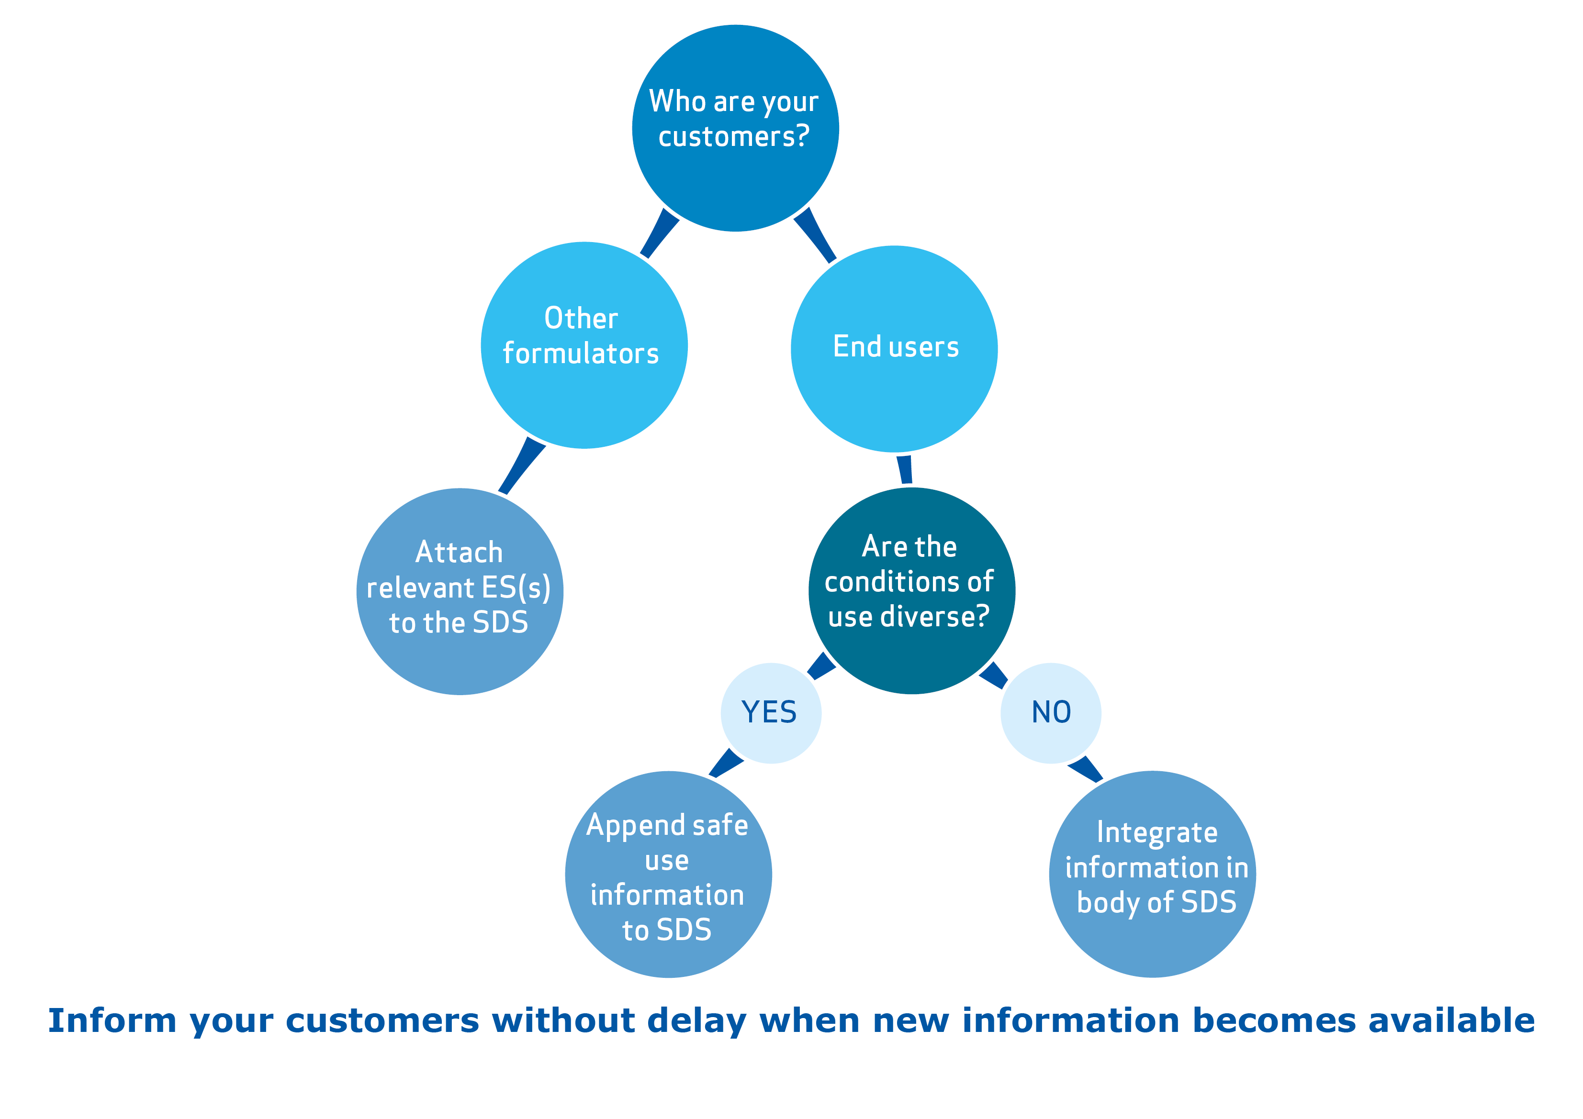
Communicating information on mixtures
Notes:
This slide illustrates the three ways to communicate the relevant safe use information in the ES of your substances further downstream to your customers receiving your mixtures. If your customers are other formulators, you should attach the relevant ESs to the SDS. This does not necessarily mean all the ESs you have received. If your customers are end-users of the mixture, you can either integrate the safe use information in body of SDS or append it to the SDS, depending on the diversity of the conditions of use.
See here for legal requirements: http://www.echa.europa.eu/documents/10162/966058/formulator_graph.pdf
For more information check the presentation “REACH and CLP: what formulators need to know” at https://echa.europa.eu/regulations/reach/downstream-users/presentations-for-downstream-users. This includes information on the methodologies used to identify the relevant information to communicate (SUMI and LCID)).

Slide 23

Why good communication matters
Registrant
Distributor
Formulator
Article Producer
End User
  Good communication in the supply chain
    Saves time
    Saves money
    Can be good for business
    Protects human health and the environment
Notes:
As well as protecting human health and the environment, good communication is good for business.

Slide 24
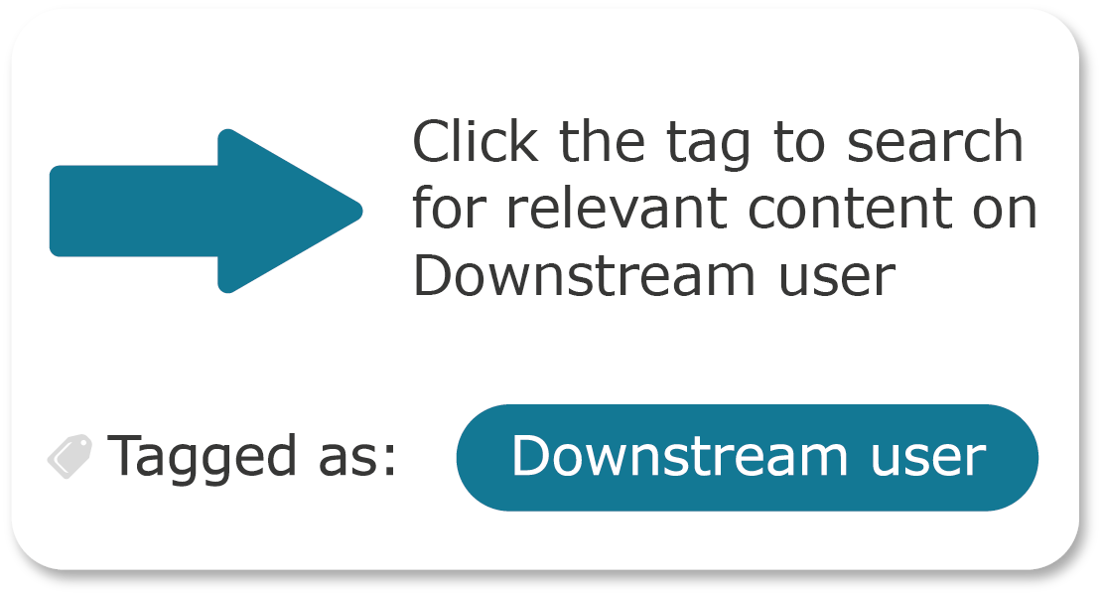
Information for Downstream users on the ECHA website
The technical, scientific and administrative aspects of REACH and CLP are managed by ECHA, the European Chemicals Agency.
Web pages containing information specifically aimed at Downstream users have been tagged “Downstream user”. Click the tag to retrieve the list of relevant content.
echa.europa.eu/regulations/reach/downstream-users
Notes:
For more general information on REACH and CLP, consult the ECHA website at echa.europa.eu

